Slide 1
CSE 5522: Survey of Artificial Intelligence II: Advanced Techniques
Instructor: Alan Ritter
TA: Fan Yang

Slide 2
Logistics
Instructor: Alan Ritter
Email: ritter.1492@osu.edu
Office: Dreese 595
Office Hours: Thursdays 3:30-4:30pm
TA: Fan Yang
yang.549@buckeyemail.osu.edu
Office: Bolz Hall 113
Office hours: Wednesday 1-2pm
Course website:
http://aritter.github.io/courses/5522.html
Homework Submission & Discussion Forums:
https://carmen.osu.edu/

Slide 3
Evaluation
Homework assignments (30%)
In-Class midterm (20%)
In-Class final (20%)
Course Project (30%)
Proposal (10%)
Code + Data (10%)
Final Report (10%)

Slide 4
Homework
Written questions
Programming exercises
Implement some algorithms discussed in class
Please use one of the following languages: C++, Java, C#, Matlab, Python
If you want to use another language, ask the instructor and TA first.
Make your code easy to run and write a README
OK to discuss with others in class.
Please write up your own answers / code.

Slide 5
Project
Team up in groups of 2-3 students
Fairly open-ended
Apply some of the methods we discuss in class to applications
Examples:
http://cs229.stanford.edu/projects2011.html

Slide 6
Project (cont)
Proposal (Due March 12)
2 pages
What is the problem you are trying to solve?
What method are you proposing to use?
What data will you use?
What is the baseline?
Final Report (Due May 30)
4 pages

Slide 7
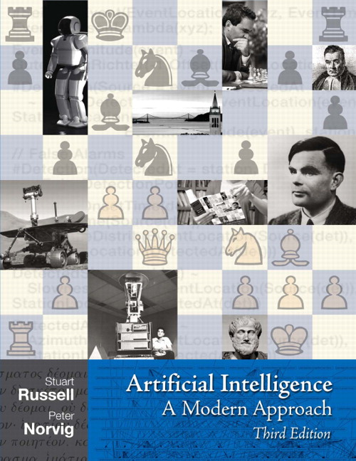
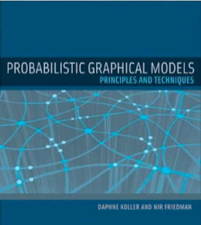
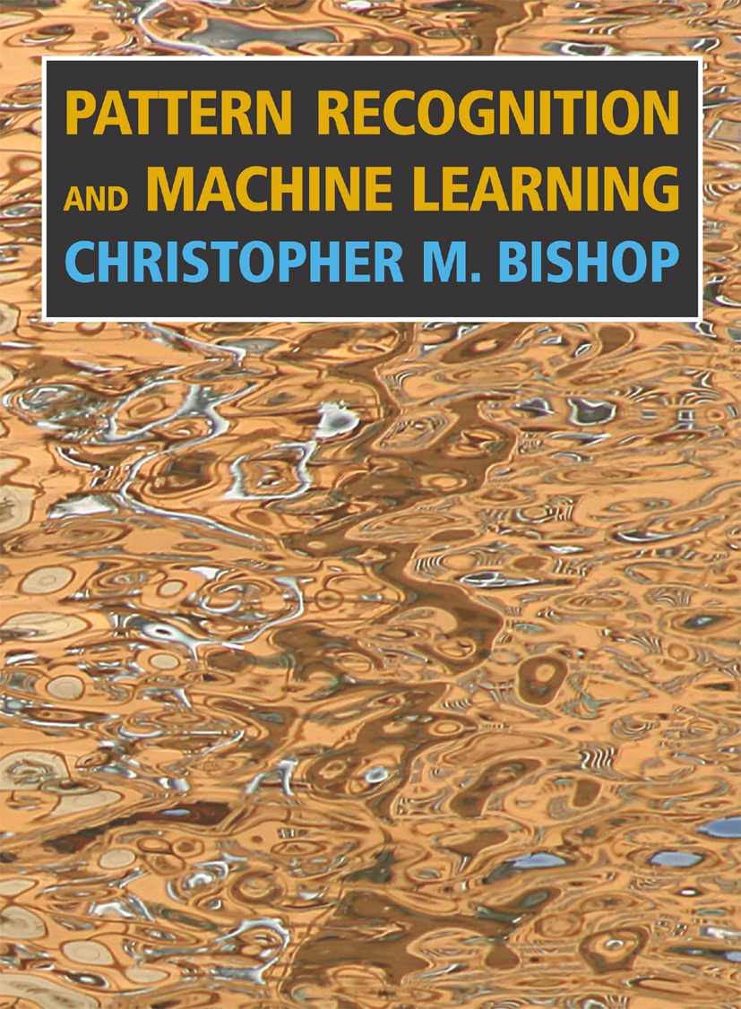
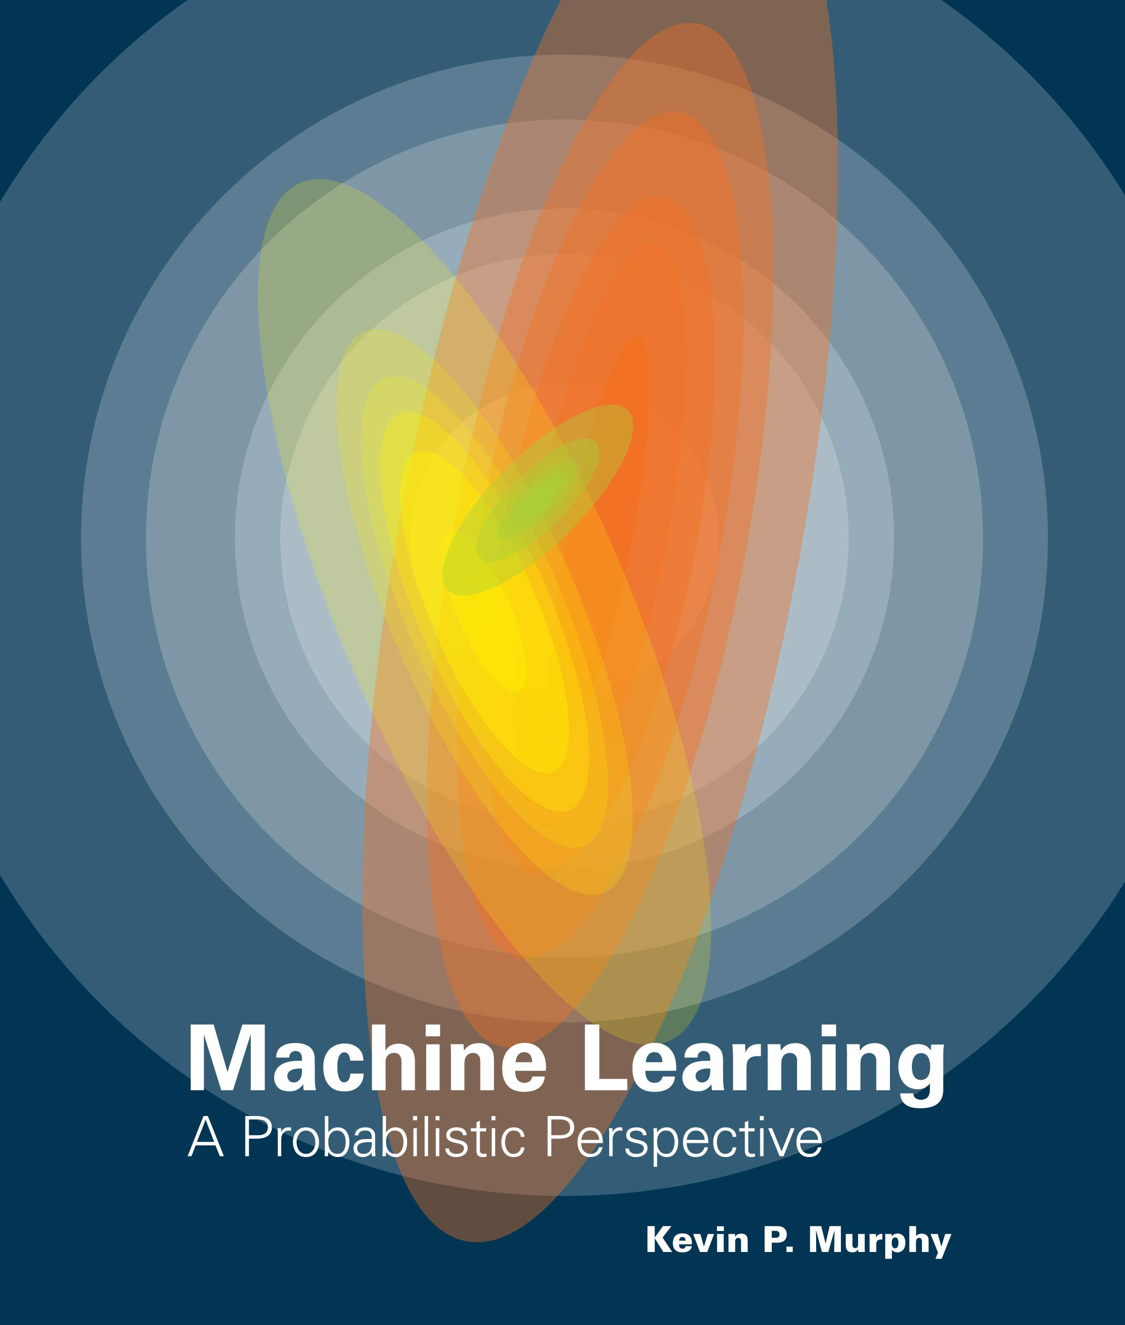
Textbooks
A number of relevant books on website
You may want these books eventually anyway…
The Russell and Norvig book is the one traditionally used for the class
But doesn’t cover all topics
I will write lecture notes and slides
Should be able to get through the class without purchasing any books.

Slide 8
Q: what is probability?
Probability: Calculus for dealing with nondeterminism and uncertainty
Probabilistic model: Can be queried to say how likely we expect different outcomes to occur.

Slide 9
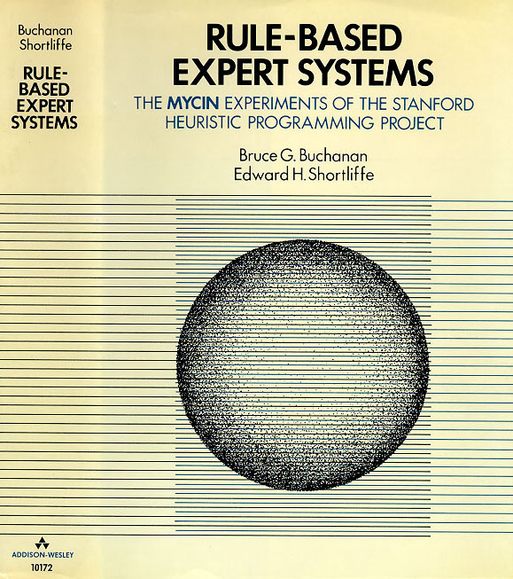
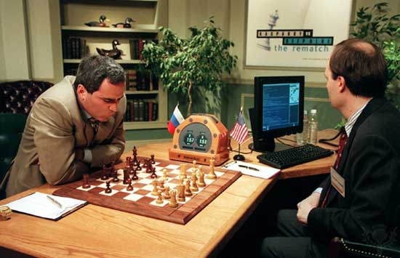
Why Should Computer Scientists Care about Probability?
Programs should have predictable behavior!
Everything should be deterministic?
Randomness is something to be avoided?
Race conditions in parallel program
If your program produces unpredictable output there must be a bug!
Symbolic AI (GOFAI)
Logic, Search
Examples: Chess, Circuit Design, Expert Systems

Slide 10
Why Should Computer Scientists Care about Probability?
Logic is not enough
The world is full of uncertainty and nondeterminism
Computers need to be able to handle this
Probability: new foundation for CS

Slide 11
What is statistics?
Statistics 1: Summarizing data
Mean, standard deviation, hypothesis testing, etc…
Statistics 2: Inferring probabilistic models from data
Structure
Parameters

Slide 12
What’s in it for Computer Scientists?
Statistics and CS are both about data
Lots of data lying around these days
Statistics lets us summarize and understand it
Statistics lets data do our work for us

Slide 13
Stats 101 vs. This Class
Stats 101 is (sort of) a prerequisite for this class
Stats 101 deals with one or two variables
We will deal with thousands or millions
Stats 101 focuses on continuous variables
We will focus on discrete ones (mostly)
Stats 101 ignores structure
We focus on computational aspects
We focus on CS applications

Slide 14
Applications of Probability and Statistics in CS
Machine Learning and Data Mining
Automated reasoning and Planning
Computer vision and graphics
Robotics
Natural language processing and speech
Information Retrieval
Databases / Data management

Slide 15
More Applications
Computer networks and systems
Ubiquitous computing
Human computer interaction
Computational biology
Computational neuroscience
Your application here ←

Slide 16
Goals for the class
We will learn to:
Put probability distributions on everything
Learn them from data
Do inference with them

Slide 17
Topics
Basics of probability and statistical estimation
Mixture models and the EM algorithm
Hidden Markov Models and Kalman Filters
Bayesian Networks and Markov Networks
Exact Inference and Approximate Inference

